Slide 1

Digital Music store data

Slide 2

Historical Information about Digital Music Stores:
How its work..
Digital music stores emerged in the late 1990s and early 2000s as online platforms to legally purchase and download digital music.
The introduction of digital music files, such as MP3, allowed for easy distribution and portability of music.
Apple's iTunes Store, launched in 2003, played a significant role in popularizing digital music purchases.
With the rise of streaming services like Spotify and Apple Music in the 2010s, digital music consumption shifted from downloads to subscription-based streaming models.
Digital music stores continue to evolve, offering a wide selection of music, personalized recommendations, and enhanced user experiences.

Slide 3
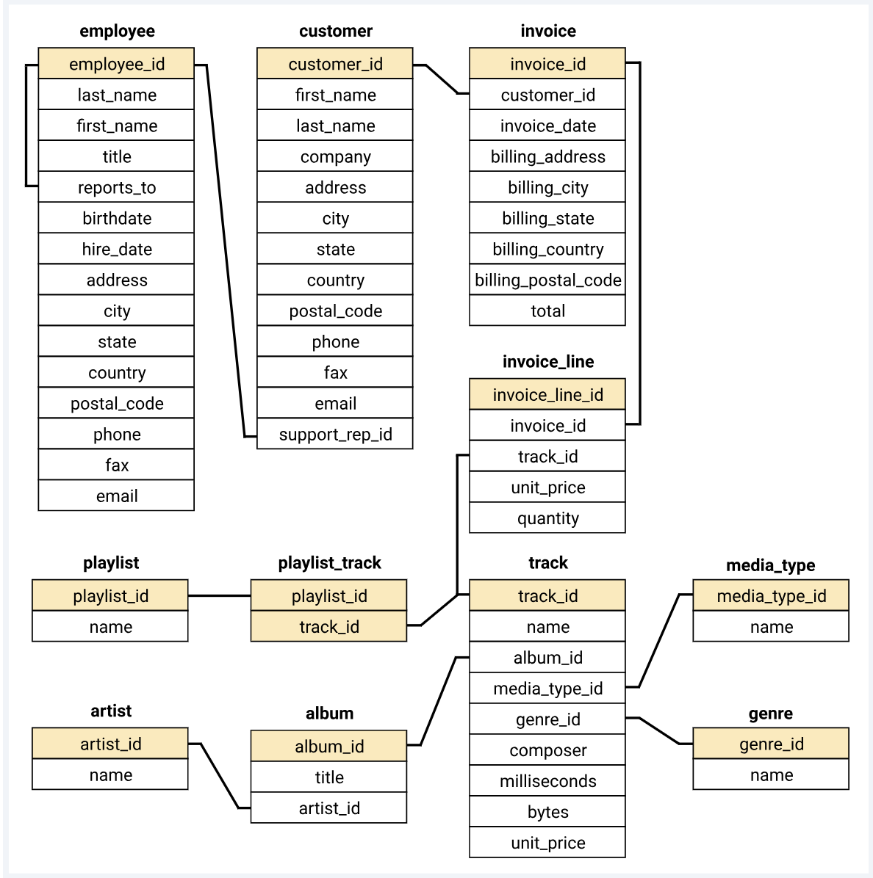
Overview
Objective:
Analysis the music store dataset ,examine the dataset with SQL and help the understand its business growth by answering questions

Slide 4
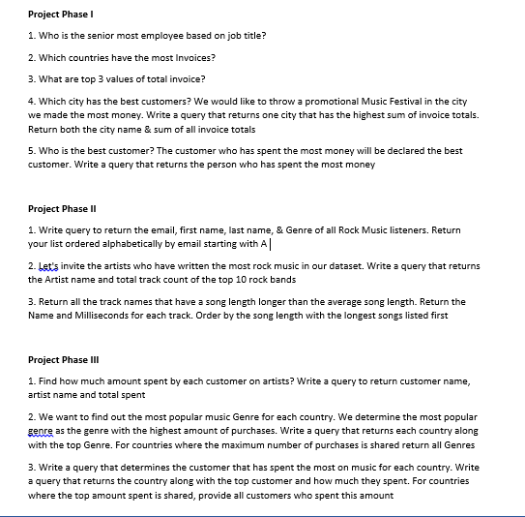

Slide 5
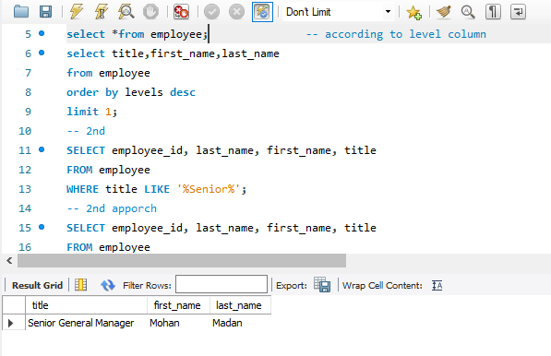
Insights
1. Who is the senior most employee based on job title?
Senior most employee is Mohan Madan (Senior General Manager)

Slide 6
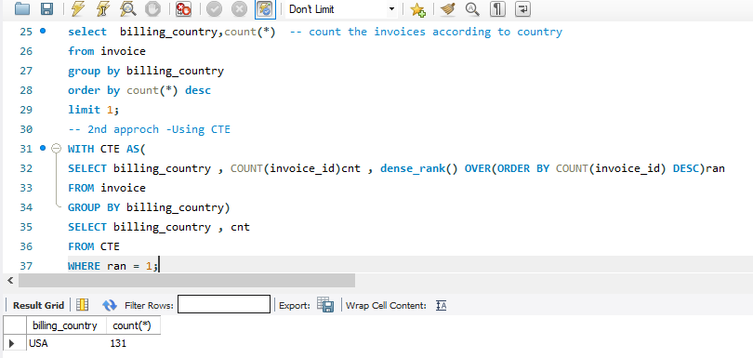
2. Which countries have the most Invoices?
It is clearly seen from the more the number of countries more will the number of invoices.
country is of North America(USA).
USA played a major role in terms of invoices invoice generated in North America.

Slide 7
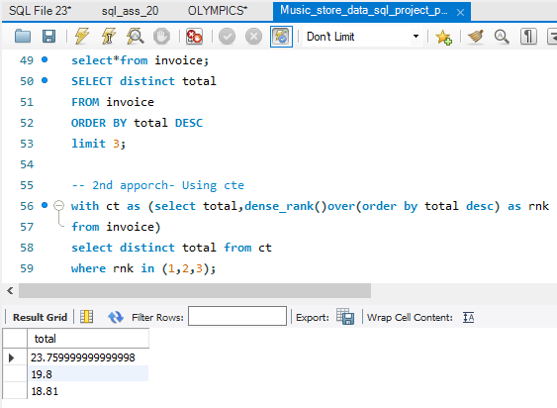
3. What are top 3 values of total invoice?
Top 3 values of total invoice contain 4 Countries.

Slide 8
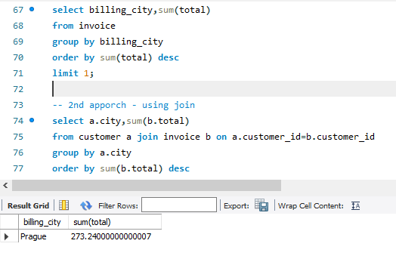
4. Which city has the best customers? We would like to throw a promotional Music Festival in the city we made the most money. Write a query that returns one city that has the highest sum of invoice totals. Return both the city name & sum of all invoice totals
These are the cities having in terms of maximum total invoice.
So for throw a promotional music festival , choose any one of these.
It is better to choose Prague because top 2 customers also belong to this city.

Slide 9
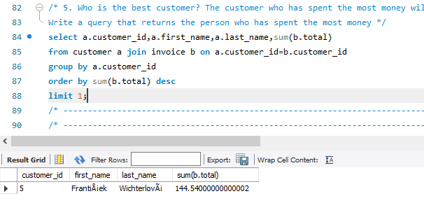
5. Who is the best customer? The customer who has spent the most money will be declared the best customer. Write a query that returns the person who has spent the most money
Frantiaiek wichterloveai-spent money 144.54

Slide 10
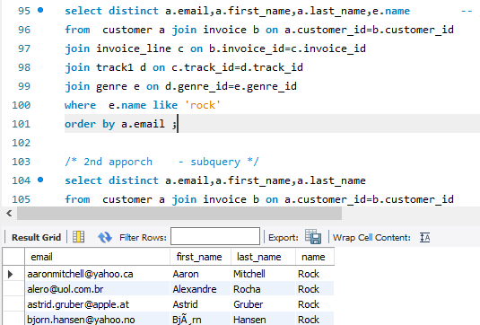
Project Phase II
1. Write query to return the email, first name, last name, & Genre of all Rock Music listeners. Return your list ordered alphabetically by email starting with A

Slide 11
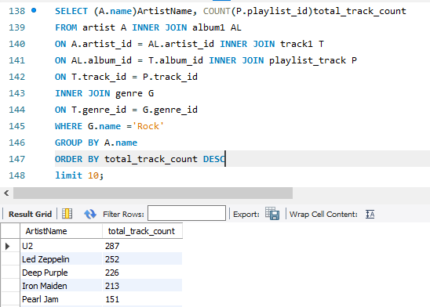
2. Let's invite the artists who have written the most rock music in our dataset. Write a query that returns the Artist name and total track count of the top 10 rock bands
These are top 10 rock bands- U2, Led zeppelin, deep purple, iron maiden, pearls jam, van halen, the rolling stones, kiss, queen, ninane

Slide 12
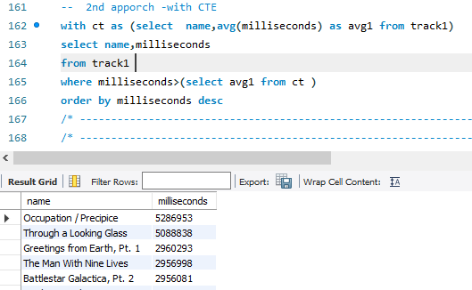
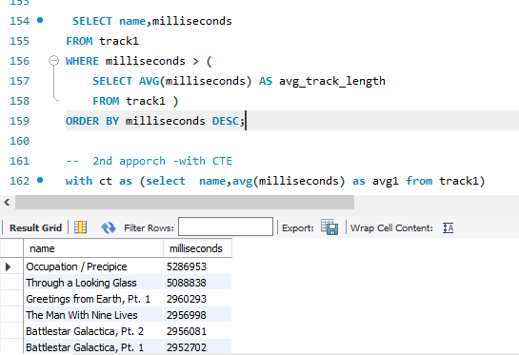
3. Return all the track names that have a song length longer than the average song length. Return the Name and Milliseconds for each track. Order by the song length with the longest songs listed first

Slide 13
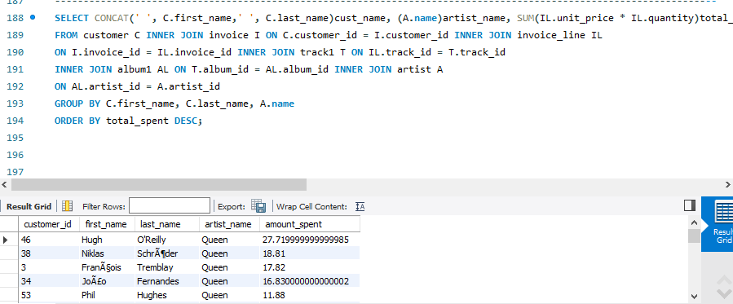
Project Phase III
1. Find how much amount spent by each customer on artists? Write a query to return customer name, artist name and total spent

Slide 14
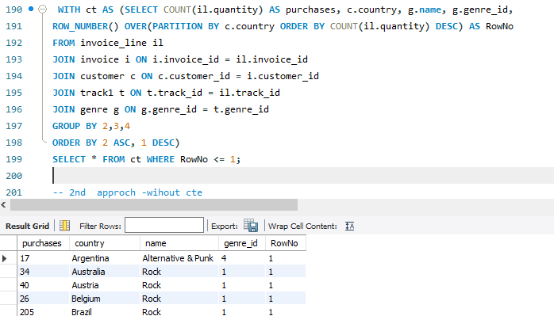
2. We want to find out the most popular music Genre for each country. We determine the most popular genre as the genre with the highest amount of purchases. Write a query that returns each country along with the top Genre. For countries where the maximum number of purchases is shared return all Genres
Rock is the only music genre which is popular in all country except Argentina.

Slide 15
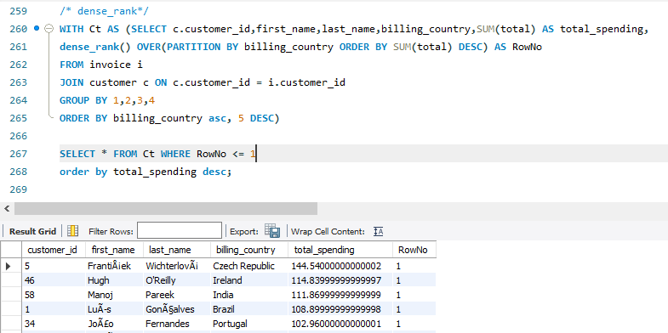
3. Write a query that determines the customer that has spent the most on music for each country. Write a query that returns the country along with the top customer and how much they spent. For countries where the top amount spent is shared, provide all customers who spent this amount
1. Frantisek wichterlova –Czech republic

Slide 16
Thank YOU!
Priyanka Gaikwad

